Slide 1





VILOKANA
TEAM CARPEDIEM

Slide 2
INTRODUCTION
A web-based platform designed to track and recover missing persons and children.
Uses Aadhaar-based authentication and AI-driven facial recognition to streamline search efforts.
Accessible via WhatsApp and web, making it user-friendly for both the public and law enforcement.
Why is it Important?
Thousands of people go missing every year, and lack of a centralized system makes recovery inefficient.
AI technology that can enhance search accuracy and speed.

Slide 3
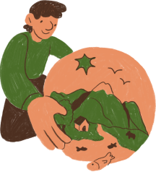
PROBLEM STATEMENT
Missing persons, especially children, pose a major societal concern.
Law enforcement and NGOs lack a real-time centralized system for tracking missing individuals.
Delays in reporting, inefficient search methods, and lack of coordination hinder recovery efforts.
There is a need for a tech-driven solution that integrates biometric verification and real-time tracking.

Slide 4

SOLUTION
Aadhaar-based registration & login for secure access.
Facial recognition using DeepFace for accurate identification via images.
WhatsApp & Web-based interface for accessibility.
AI-powered search visualization using an XGBoost model to suggest search zones.
Real-time location updates whenever a sighting is reported.
Multilingual chatbot to assist users across different languages.
Dedicated dashboards for police & NGOs for quick alerts and insights.
IMPACT
Faster identification and reunification.
Improved coordination between authorities and the public.
Scalable and accessible for different stakeholders.

Slide 5
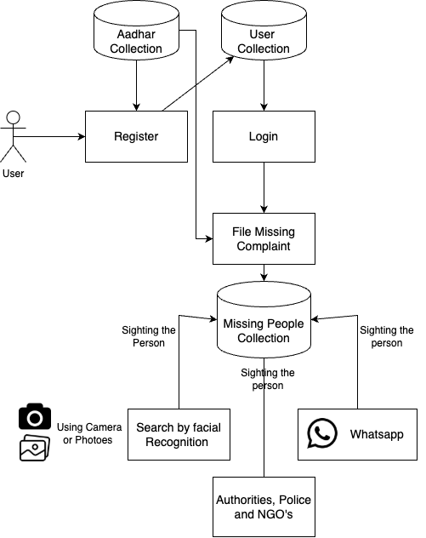
ARCHITECTURE

Slide 6

CONCLUSION
Vilokana bridges the gap between technology and humanitarian efforts.
AI-driven accuracy enhances missing persons tracking.
WhatsApp & web accessibility makes it easy for both users and authorities.
Real-time updates & intelligent search improve search efficiency.
VILOKANA IS NOT JUST AN APP—IT’S A STEP TOWARD REUNITING FAMILIES!

